Slide 1


Slide 2
laravel artisan revision
Php artisan //To Show All Laravel Command
php artisan make:auth // To Create Authentication
php artisan make:controller // To Create Controller
php artisan make:model // To Create model
php artisan make:migration // To Create migration

Slide 3
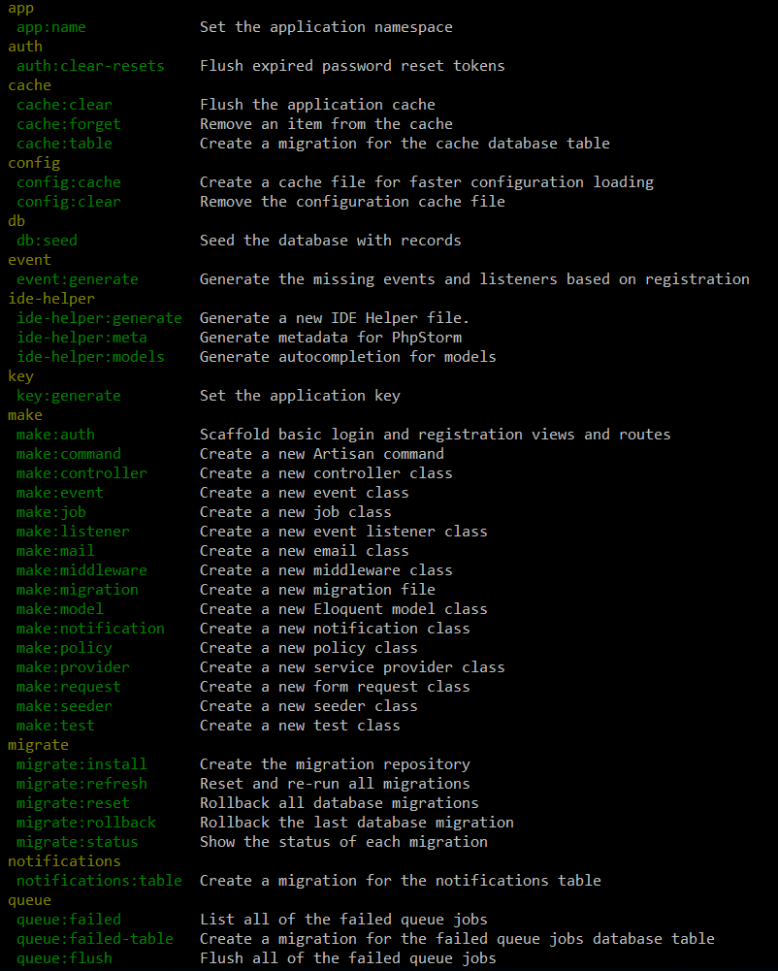
Artisan !
Artisan is command-line interface for Laravel
Commands that are saving time
Generating files with artisan is recommended
Run php artisan list in the console

Slide 4
php artisan make:auth –h Authentication
Description:
Scaffold basic login and registration views and routes
Usage:
make:auth [options]
Options:
--views Only scaffold the authentication views
--force Overwrite existing views by default

Slide 5
php artisan make:controller –h Controller
Description:
Create a new controller class
Usage:
make:controller [options] [--] <name>
Arguments:
name The name of the class
Options:
-m, --model[=MODEL] Generate a resource controller for the given model.
-r, --resource Generate a resource controller class.
--api Exclude the create and edit methods from the controller.
EX suggestion
php artisan make:controller EmpController -r -m emp

Slide 6
php artisan make:model -h Model
Description:
Create a new Eloquent model class
Usage:
make:model [options] [--] <name>
Arguments:
name The name of the class
Options:
-a, --all Generate a migration, factory, and resource controller for the model
-c, --controller Create a new controller for the model
--force Create the class even if the model already exists
-m, --migration Create a new migration file for the model
-r, --resource Indicates if the generated controller should be a resource controller
EX suggestion
php artisan make:model -mcr Model/test
php artisan make:model --migration --controller --resource test

Slide 7
php artisan make:migration -h Migration
Description:
Create a new migration file
Usage:
make:migration [options] [--] <name>
Arguments:
name The name of the migration
Options:
--create[=CREATE] The table to be created
related
php artisan migrate
php artisan migrate:fresh //Drop all tables and re-run all migrations
php artisan migrate:install //Create the migration repository
php artisan migrate:refresh //Reset and re-run all migrations
php artisan migrate:reset //Rollback all database migrations
php artisan migrate:rollback //Rollback the last database migration
php artisan migrate:status //Show the status of each migration
EX suggestion
php artisan make:migration emp --create=cars

Slide 8
resource
related
php artisan route:list //List all
Route::resource('Car','CarController');
"Route::resource('$1','$1Controller');\n php artisan make:model -mcr Model/$1",

